Slide 1
Volumes: Attaching Disk Storage to Containers
Week 7

Slide 2
Agenda
Volumes
emptyDir
hostPath
PersistentVolumes (PV) and PersistentVolumeClaims (PVC)
StorageClass

Slide 3
K8s Volumes
Unlike Network, processes and CPU, filesystems are unique per container
Used to persist data between container invocations
Can be shared by containers in a pod
Defined as part of the pod spec
Share pod’s lifecycle
Initiated when pod starts
Terminated when a pod is terminated

Slide 4
Volumes
Volumes are special directories that are mounted in containers
Volumes can have many different purposes:
share files and directories between containers running on the same machine
share files and directories between containers and their host
centralize configuration information in Kubernetes and expose it to containers
manage credentials and secrets and expose them securely to containers
store persistent data for stateful services

Slide 5
Volumes vs PersistentVolumes
Volumes and Persistent Volumes are related, but very different!
Volumes:
appear in Pod specifications (we'll see that in a few slides)
do not exist as API resources (cannot do kubectl get volumes)
Persistent Volumes:
are API resources (can do kubectl get persistentvolumes)
correspond to concrete volumes (e.g. on a SAN, EBS, etc.)
cannot be associated with a Pod directly; but through a Persistent Volume Claim
won't be discussed further in this section

Slide 6
Volume Types
emptyDir—A simple empty directory used for storing transient data.
hostPath—Used for mounting directories from the worker node’s filesystem into the pod.
gitRepo—A volume initialized by checking out the contents of a Git repository.
nfs—An NFS share mounted into the pod.
gcePersistentDisk (Google Compute Engine Persistent Disk)
awsElasticBlockStore (Amazon Web Services Elastic Block Store Volume)
azureDisk (Microsoft Azure Disk Volume)—Used for mounting cloud provider-specific storage.

Slide 7
Volume Types, Cont
cinder, cephfs, iscsi, flocker, glusterfs, quobyte, rbd, flexVolume, vsphereVolume, photonPersistentDisk, scaleIO—Used for mounting other types of network storage.
configMap, secret, downward API—Special types of volumes used to expose certain Kubernetes resources and cluster information to the pod.
persistentVolumeClaim—A way to use a pre- or dynamically provisioned persistent storage.

Slide 8
Volume Type: emptyDir
We will start with the simplest Pod manifest we can find
We will add a volume to that Pod manifest
We will mount that volume in a container in the Pod
By default, this volume will be an emptyDir (an empty directory)
It will "shadow" the directory where it's mounted

Slide 9
Volume Lifecycle
The lifecycle of a volume is linked to the pod's lifecycle
This means that a volume is created when the pod is created
This is mostly relevant for emptyDir volumes
(other volumes, like remote storage, are not "created" but rather "attached" )
A volume survives across container restarts
A volume is destroyed (or, for remote storage, detached) when the pod is destroyed

Slide 10
Workshop 1 – Using EMPTYDIR volume to share data between containers in the Pod
Notes:
https://github.com/luksa/kubernetes-in-action/tree/master/Chapter06

Slide 11
Goals
Deployment of containerized application that uses emptyDir Volume to share data between containers
Notes:
https://www.eksworkshop.com/beginner/170_statefulset/services/

Slide 12
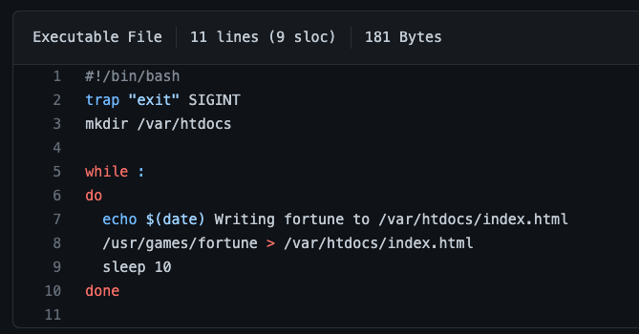
Description
Application is running as two containers in the same pod
One process is generating random fortune every 10 seconds and writes it to a shared volumes
The same volume is mounted into nginx container as /usr/share/nginx/html. Nginx serves the fortunes from this folder
Notes:
https://www.eksworkshop.com/beginner/170_statefulset/services/
https://github.com/luksa/kubernetes-in-action/tree/master/Chapter06

Slide 13

Description
Application is running as two containers in the same pod
One process is generating random fortune every 10 seconds and writes it to a shared volumes
The same volume is mounted into nginx container as /usr/share/nginx/html. Nginx serves the fortunes from this folder
Notes:
Pp 164 in K8s in action

Slide 14
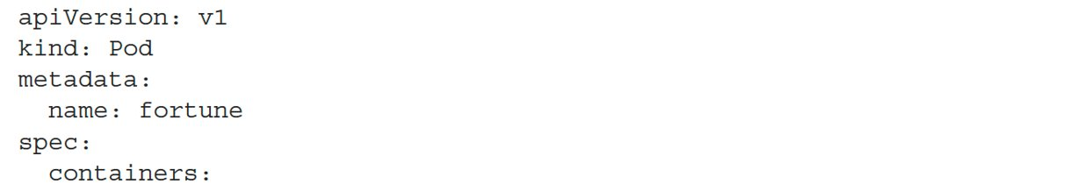
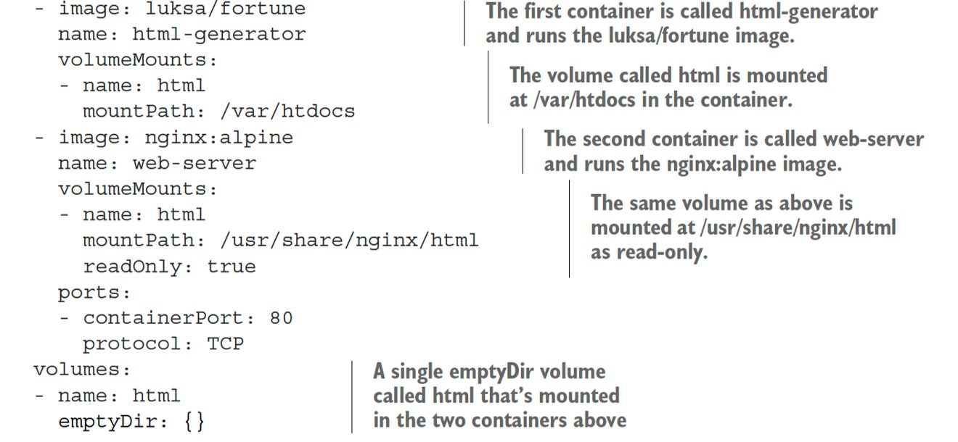
Pod Manifest

Slide 15
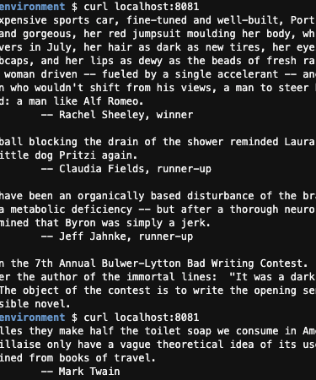
Deploy and Access the application
# Create a namespace
$ k create ns week8
$ k apply -f fortune_pod.yaml -n week8
$ k get all –n week8
# Deploy the pod
# Access the app via port forwarding
$ kubectl port-forward fortune 8080:80 -n week8
$ curl http://localhost:8080
Notes:
htt

Slide 16

Examine the mounted volume
# Attach shell to web-server container inside fortune Pod
$ k exec fortune -it -n week8 -c web-server -- sh
/ # cat /usr/share/nginx/html/index.html
Try the Moo Shu Pork. It is especially good today.
# Wait 10 seconds
/ # cat /usr/share/nginx/html/index.html
You will be run over by a beer truck.
# Try upating the index.html file
/ # vi /usr/share/nginx/html/index.html
Why does the editing attempt fail?

Slide 17
End of Workshop 1

Slide 18
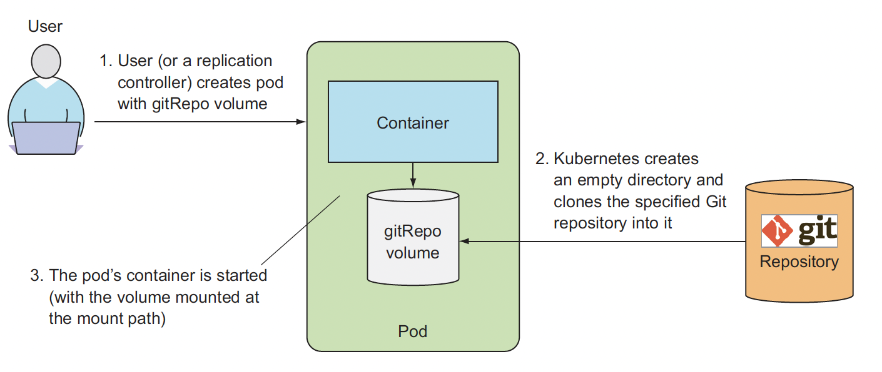
Using GitRepo Volume

Slide 19
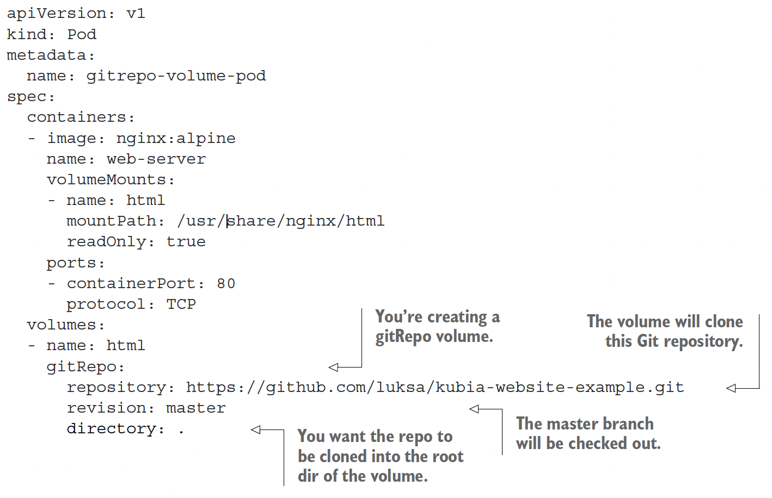
Pod Manifest with GitRepo

Slide 20
Managing configuration
Some applications need to be configured
There are many ways for our code to pick up configuration:
command-line arguments
environment variables
configuration files
configuration servers (getting configuration from a database, an API...)
... and more (because programmers can be very creative!)
How can we do these things with containers and Kubernetes?

Slide 21
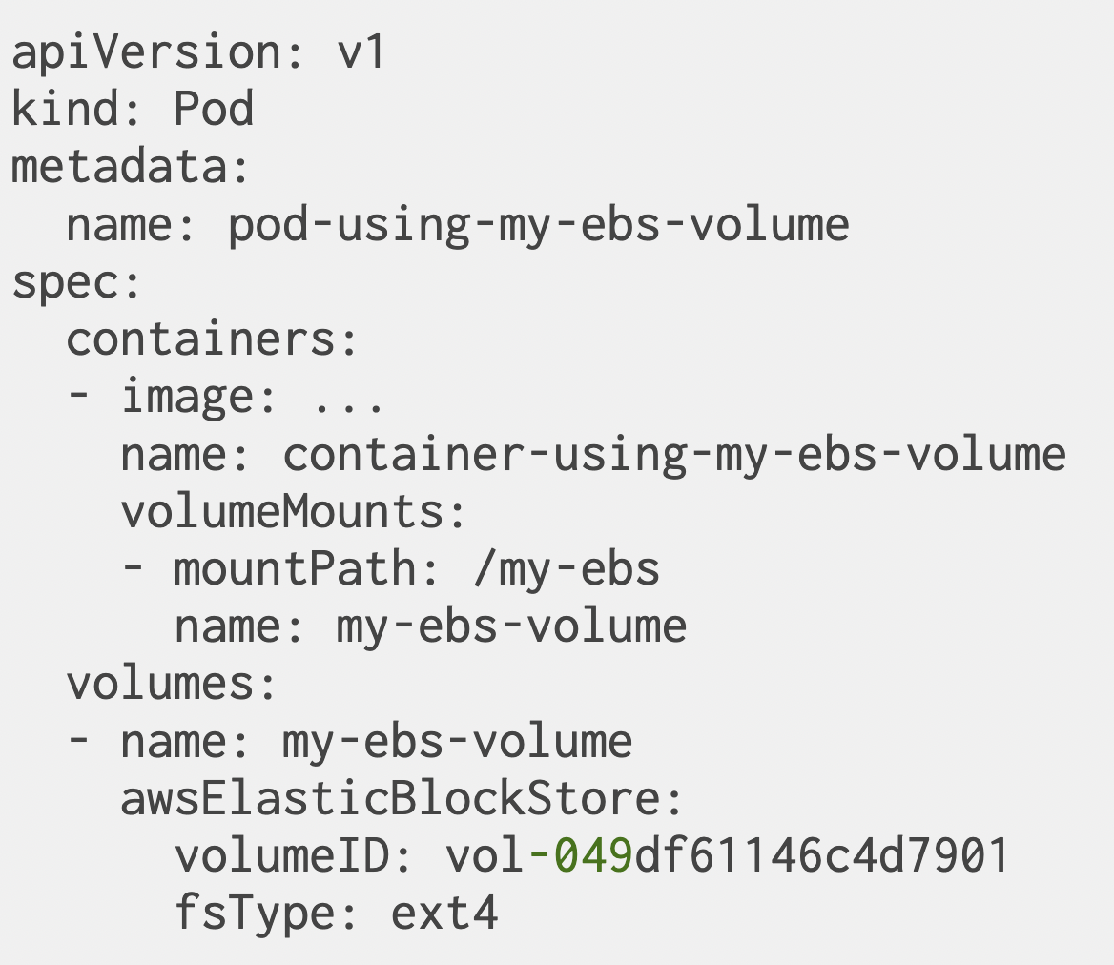
Persistent Volumes: Amazon EBS
Using a persistent volume requires:
creating the volume out-of-band (outside of the Kubernetes API)
referencing the volume in the pod description, with all its parameters

Slide 22
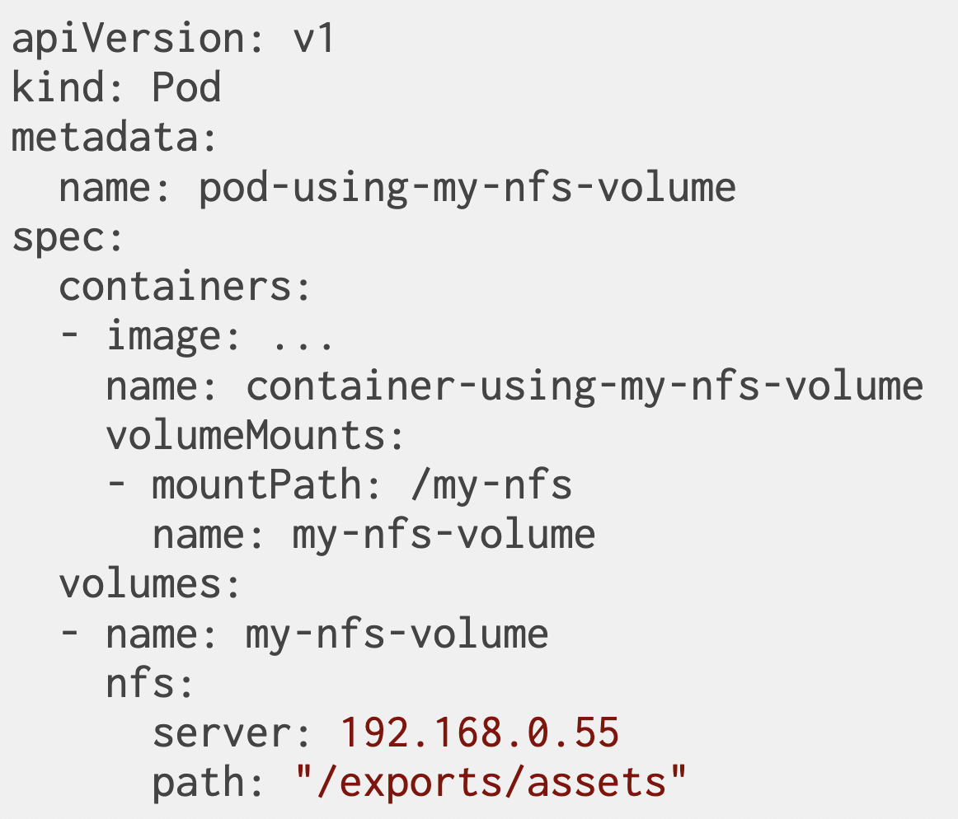
Using NFS Volume

Slide 23
Workshop 2 – Intorducing InitContainer and gitrepo Volume
Notes:
https://github.com/luksa/kubernetes-in-action/tree/master/Chapter06

Slide 24
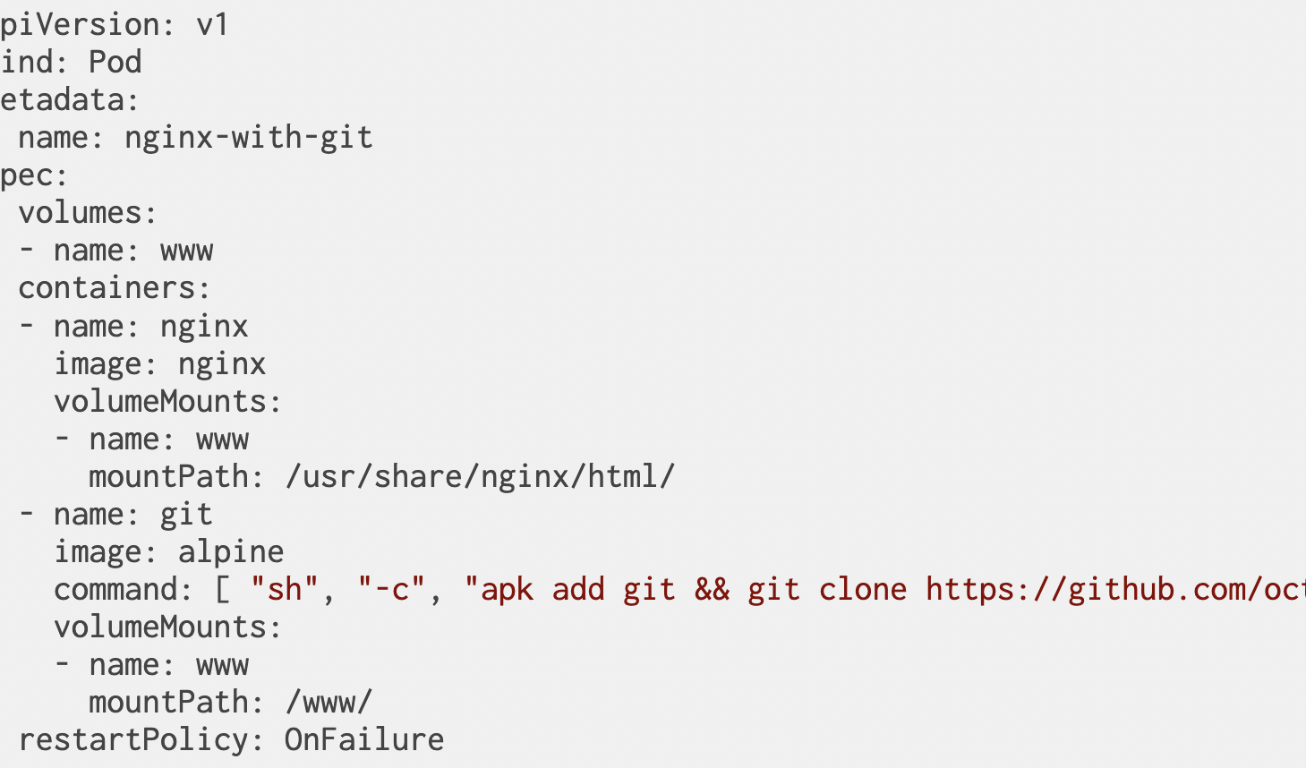
Sharing a volume between two containers
$ kubectl create –f nginx_with_git.yaml -n week8
k port-forward pod/nginx-with-git 8080:80 -n week8
$ curl localhost:8080
Notes:
https://github.com/octocat/Spoon-Knife

Slide 25
The devil is in the details
The default restartPolicy is Always
This would cause our git container to run again ... and again ... and again (with an exponential back-off delay, as explained in the documentation)
That's why we specified restartPolicy: OnFailure

Slide 26
Using Init Containers
The webserver should be started _after_ the repository is cloned
Starting simultaneously will cause a short downtime
We can define containers that should execute before the main ones
They will be executed in order
(instead of in parallel)
They must all succeed before the main containers are started

Slide 27
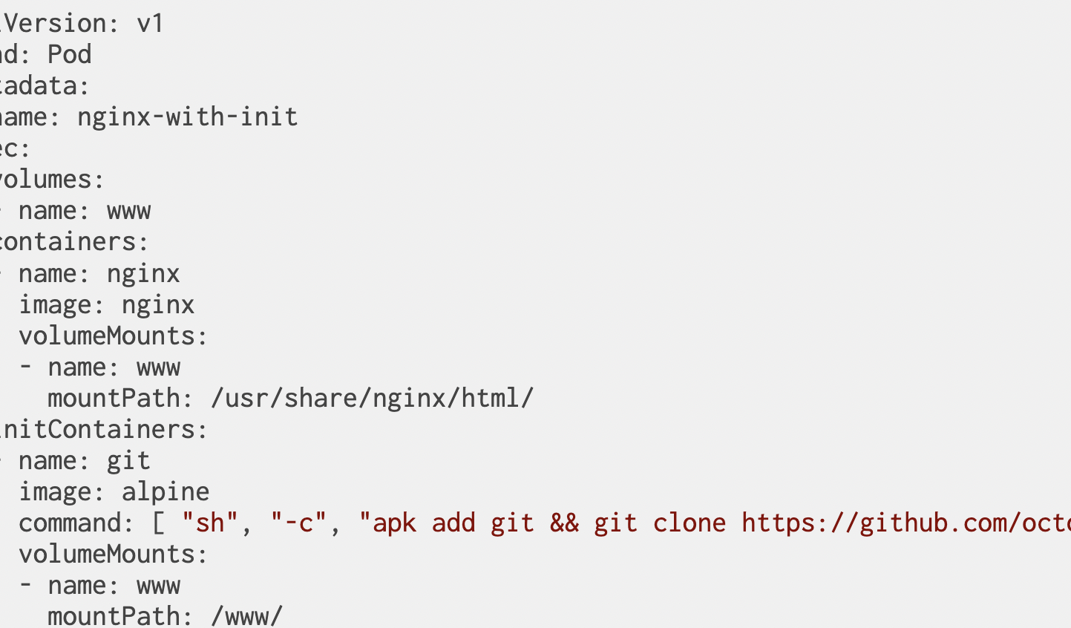
Defining Init Containers
$ kubectl create –f nginx_with_init.yaml -n week8
k port-forward pod/nginx-with-init 8080:80 -n week8
$ curl localhost:8080
Notes:
https://container.training/kube-selfpaced.yml.html#1271

Slide 28

Cleanup!
# This command is your best friend from now on.
$eksctl delete cluster --name clo835 --region us-east-1

Slide 29
Workshop 2 – the End

